Slide 1
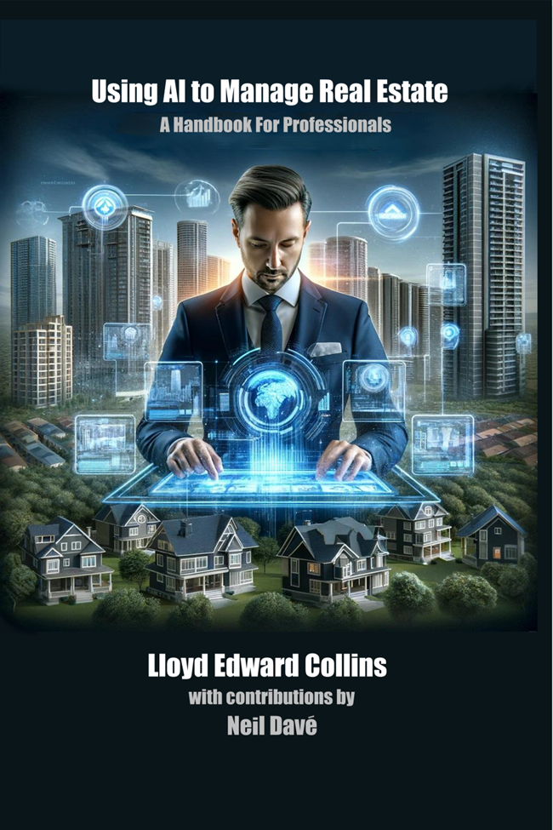
Optimizing Real Estate Management with AI: A Proposal for Westpark
Presented by Lloyd Collins & Neil Davé

Slide 2
Founding of Real Estate AI Group:
Pioneering AI in Real Estate
Company Mission:
Applying AI technology to optimize real estate operations
Specialization: Maintenance cost analytics, predictive maintenance, cost control

Slide 3
Introduction
Objective: To leverage AI technology to optimize maintenance operations, reduce costs, and improve efficiency at Westpark
Key Points:
100 years of progressive experience in real estate and technology.
Expertise in AI/LLM for real estate management.
Proven results in cost reduction and operational efficiency.

Slide 4
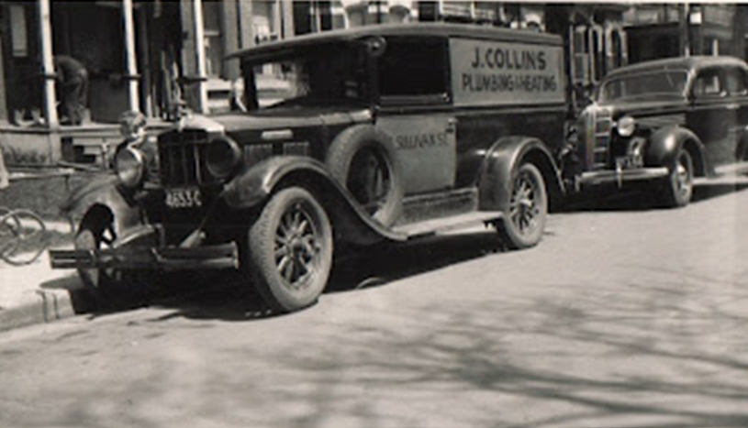
Over 100 Years of Experience
A Century of Real Estate AI Group
1922: Foundation of early mechanical expertise, carried through multiple generations - still operating 2024
1980 – 1990’s: Leadership in NET, NASDAQ listing.. VP / GM over $100M division . VP Asia Pacific / Latin America (offices Hong Kong, Tokyo, Singapore)
1990’s: Founding Technology Gateways Int’l..
Satellite systems integration
2010: RightOn Health (Machine Learning)
2022: Covid Authority – risk mitigation
2023: Real Estate AI Group.. AI in managing real estate

Slide 5
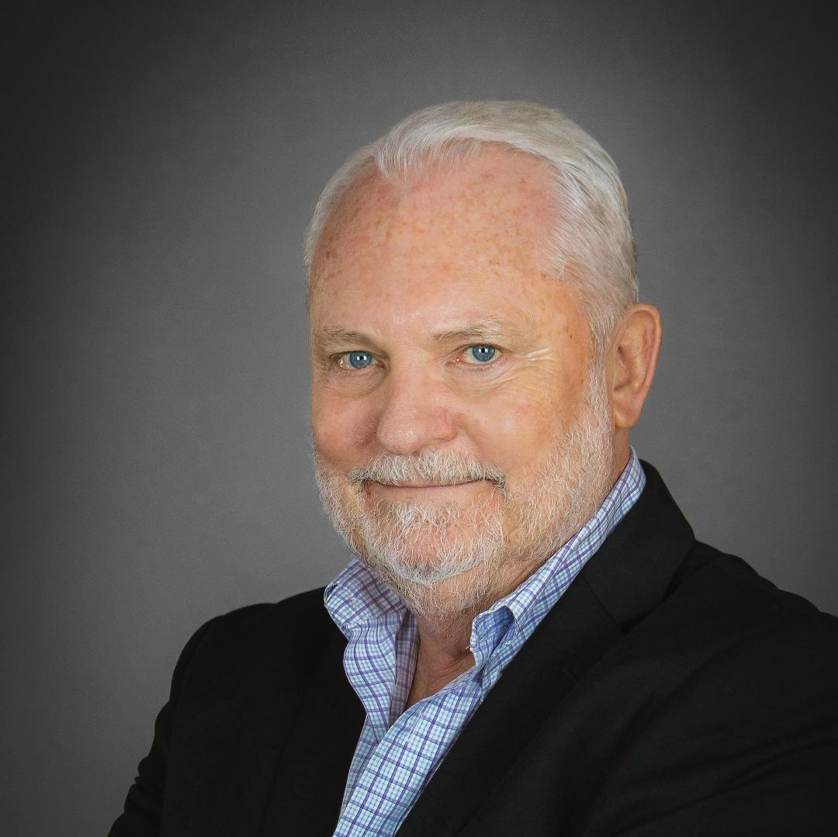
Experienced Leadership Team
Lloyd Collins
Graduate Engineer
P.Eng degree
Founder / CEO
High Tech Leadership in Silicon Valley
Companies: Technology Gateways Int’l
RightOn Health
Covid Authority
Real Estate AI Group

Slide 6
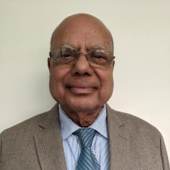
Experienced Leadership Team
Neil Davé
CTO (Chief Technology Officer)
PhD in Physics, MS Computer Science
Co-Founder of multiple AI –driven companies
Commercial property investor and operator

Slide 7
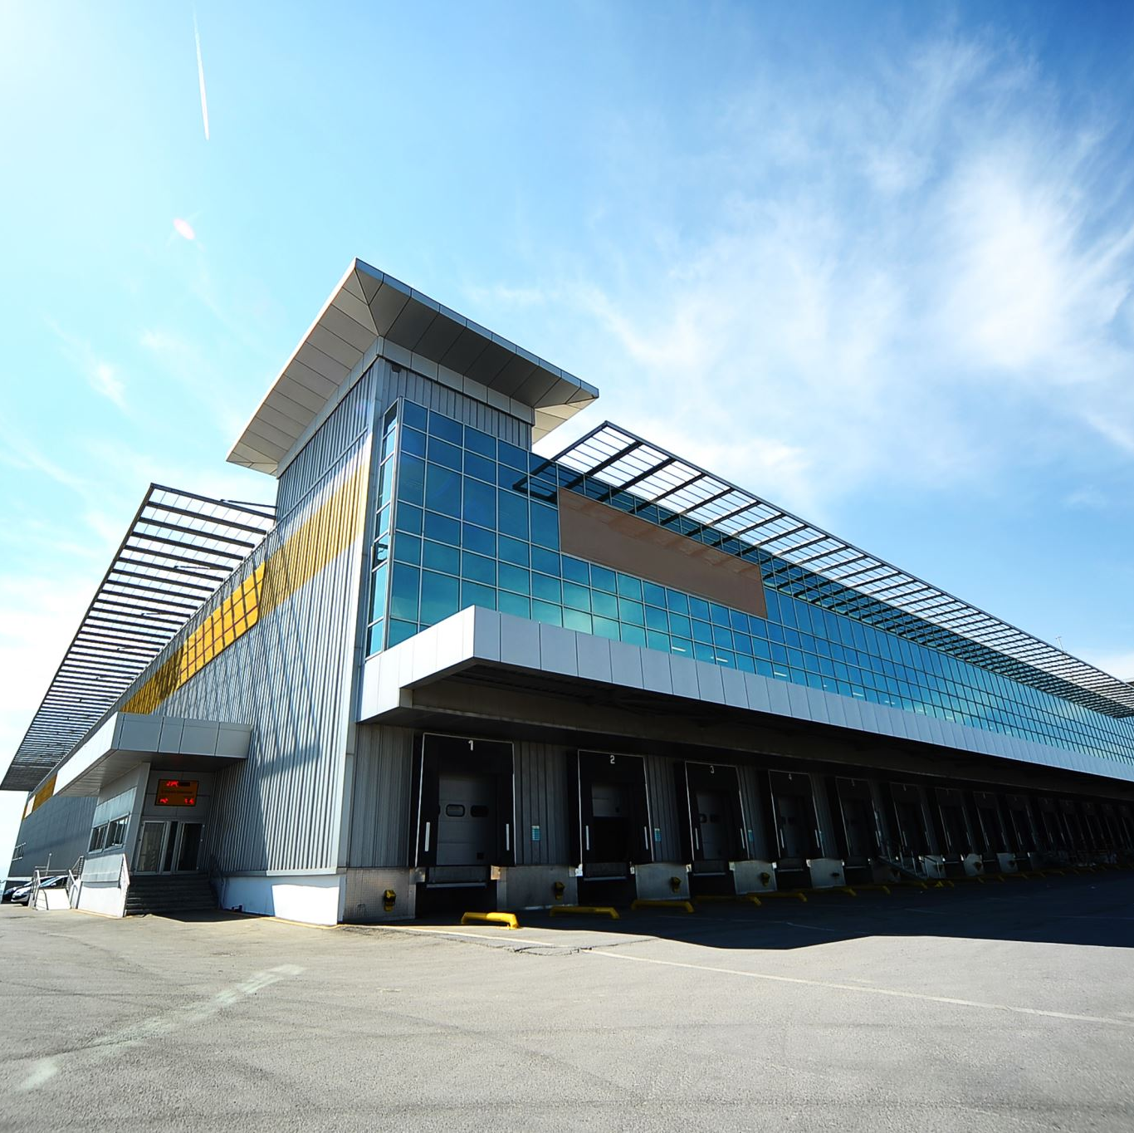
Evolving Expertise
From Mechanical to AI-Driven Solutions
Mechanical Expertise: Plumbing, heating, general contracting
Technical Leadership: Experience in high-tech, global operations and biomedical AI
Real Estate Focus: Experience in large commercial buildings, including major renovations. Renovation of a major hotel complex in Santa Cruz, CA

Slide 8
Our Expertise in Real Estate Management
Proven Success in Real Estate Management
Experience: Management of large commercial properties, total renovation of Silicon Valley buildings
Case Study Example:
Operated and owned Profitable Large Hospitality LLC's at National Level .
Owner/Operator: Fireside Inn, Santa Cruz, CA.

Slide 9
AI Technology for Maintenance Optimization
Revolutionizing Maintenance with AI
Tailored Solution for Westpark
Graph / Chart: Predicted cost savings and increased uptime as next slide
Key Benefits:
Up to 70% reduction in maintenance expenses (Deloitte)
Predictive Maintenance to avoid costly repairs
Optimize maintenance processes: Scheduling, preventative maintenance, vendor management
Case Study Example:
Increased REV Par by 300% in Hotels over 45 year ownership history.

Slide 10
Reduction in Maintenance Costs: This chart shows a significant decrease in maintenance costs over time after the implementation of AI, illustrating a 40% reduction. Other projects have indicated up to 70% reduction in maintenance costs

Slide 11
Increase in Equipment Uptime: This chart demonstrates a 10% improvement in equipmenet uptime due to the use of predictive maintenance powered by AI

Slide 12
Reduction in Emergency Repairs: The final chart highlights a 50% reduction in emergency repairs after AI implementation, showing how predictive maintenance can prevent costly and unexpected breakdowns

Slide 13
Benefits to Westpark
What You Will Gain
Significant cost savings
Enhanced operational efficiency
Predictable maintenance and reduced downtime
Long-term sustainability and value rention

Slide 14
Implementation Plan
How We Will Achieve Success
Phase 1: Initial consultation- Review and analysis of current operations
Create Westpark “real data” charts as above
Phase 2: Data cleansing - Ensure accuracy for analytics
Phase 3: AI Model Deployment – Tailored AI solutions for predictive maintenance
Phase 4: Ongoing Support – Continuous monitoring and adjustment

Slide 15
Next Steps
Let’s Get Started!!
Phase 1: Initial consultation- Review and analysis of current operations
Create Westpark “Real Data”

Slide 16
Questions and Answers

